Slide 1



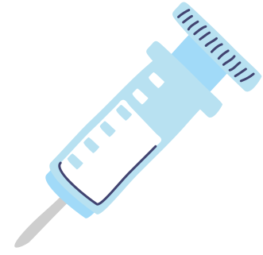






Digital Signal Processing
in Medical Industry -
Medical Portable Devices
Presented By : Shajhan Sangrasi, Daniyal Areshia

Slide 2

Digital
Signal
Prcessing!!!
Digital signal processing (DSP) is extensively utilized in the medical industry for tasks such as signal filtering, noise reduction, and image enhancement in various diagnostic modalities like MRI, CT scans, and ultrasound. It aids in extracting valuable information from medical signals, enabling accurate diagnosis and treatment planning.
Naam to sunna hogga ;)
Additionally, DSP techniques are employed in wearable medical devices for real-time monitoring of vital signs, facilitating remote patient monitoring and personalized healthcare delivery.

Slide 3
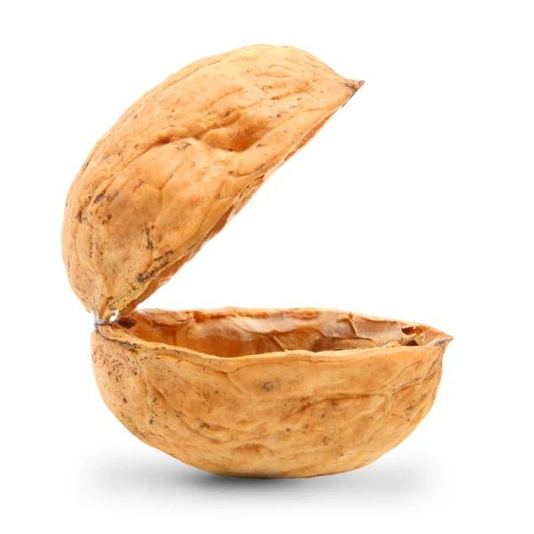
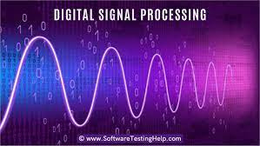
Medical Industry and DSP in a NUTSHELL
Modern digital signal processing makes use of a variety of mathematical techniques. These techniques are used to design and understand efficient filters for data processing and control.
Some DSP techniques are based on complex mathematics, such as Fast Fourier Transform (FFT), z-transform, representation of periodical signals and linear systems, etc.
A DSP is designed for performing mathematical functions like “add”, “subtract”, “multiply” and “divide” very quickly

Slide 4
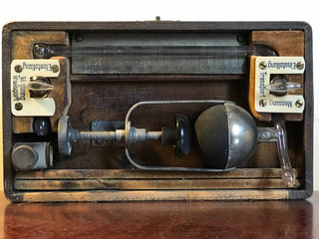
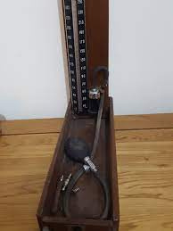
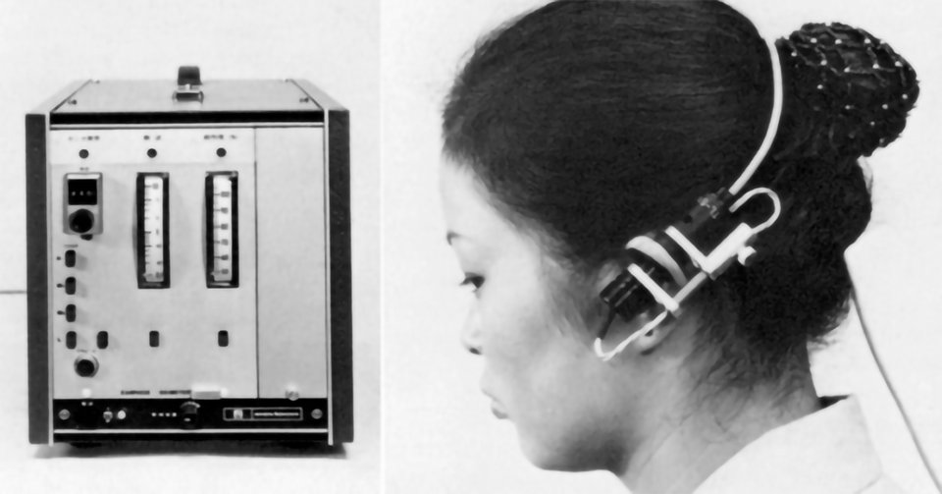
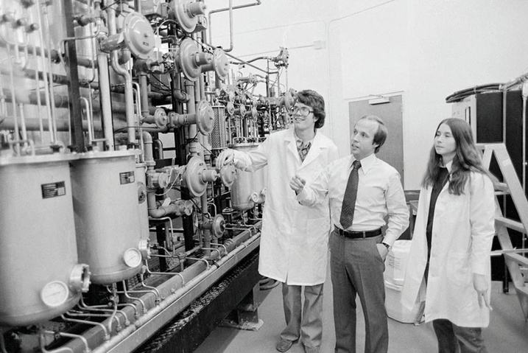
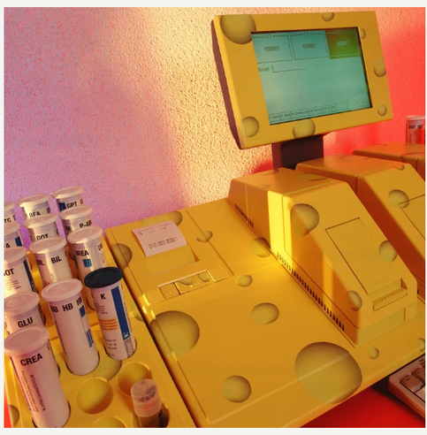
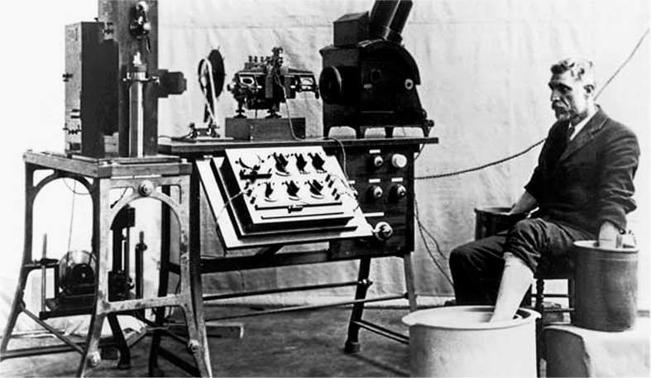
Blood pressure monitoring device
Pulse monitoring device
Glucose Monitoring System
String galvanometer electrocardiograph

Slide 5
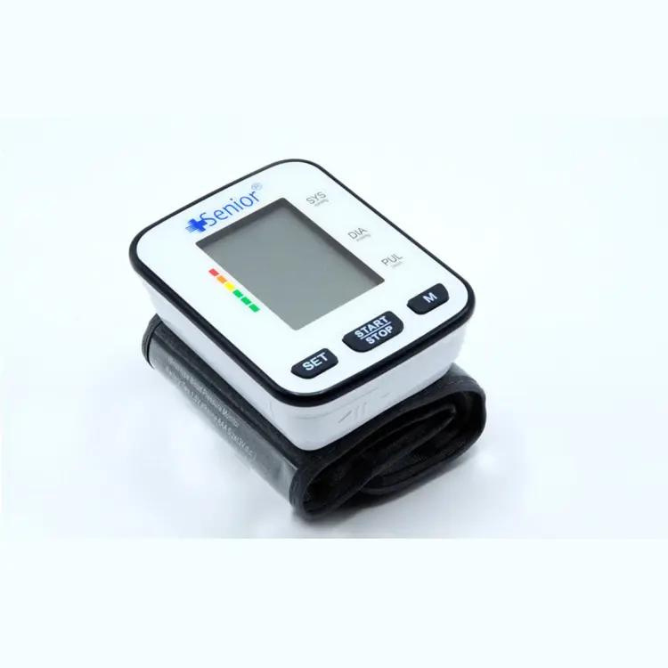
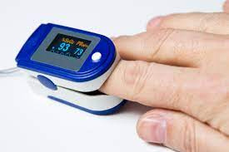
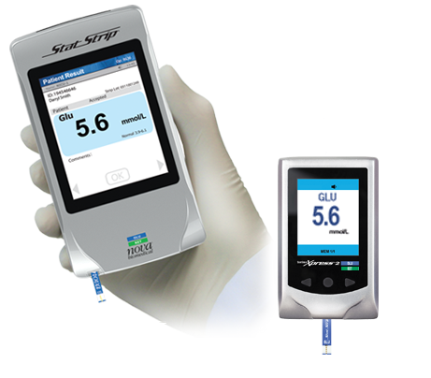
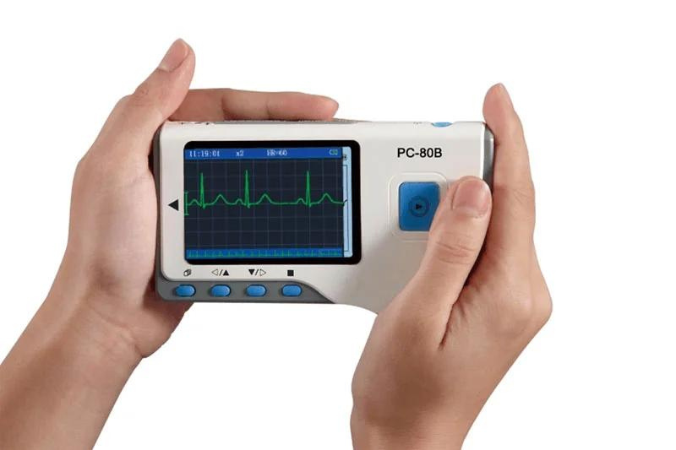
Digital Automatic Wrist Blood Pressure Monitor With High and Low BP Indicator And Pulse Measurement
Finger Print Pulse Oximeter (noninvasive test)
Glucose/Ketone Monitoring System | Nova Biomedical Corporation
Lepu-Creative PC-80B Portable EKG Monitor Manufacturer, Handheld ECG Reader Machine

Slide 6


How come Medical Industry has transformed at such scale?
How come these devices has minuaturized?

Slide 7

Digital
Signal
Prcessing!!!

Slide 8
Advancements in DSP has been instrumental in the miniaturization of medical devices.
It has enabled the processing of complex signals in real-time within a small form factor. DSP chips have become smaller and more energy-efficient, allowing for their integration into compact medical devices.
Including other Key factors like Microelectromechanical Systems (MEMS), Integration of AI and Wireless Technologies, Silicon Ultrasound Technology:

Slide 9
LETS DIVE DEEPER!

Slide 10
Pulse Oximetry
Pulse Oximetry is a non-invasive method used to measure the oxygen saturation level in the blood. It’s widely used in various medical and consumer-grade applications
. The DSP in the pulse oximeter processes these time-varying signals to calculate the oxygen saturation level
The mathematical principle behind pulse oximetry is the Beer-Lambert law, which states that the absorption of light is directly proportional to the concentration of the medium and the distance it has travelled
Working Principle??

Slide 11
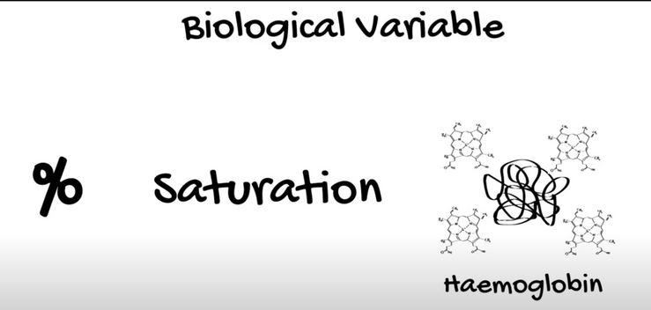
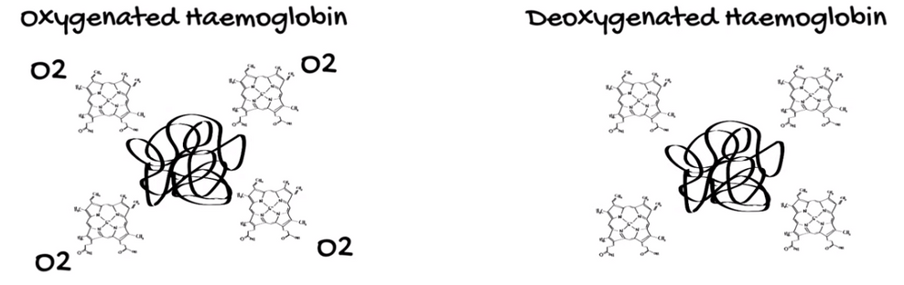
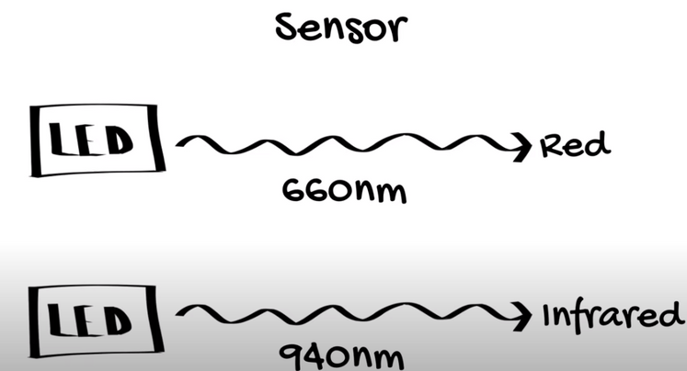
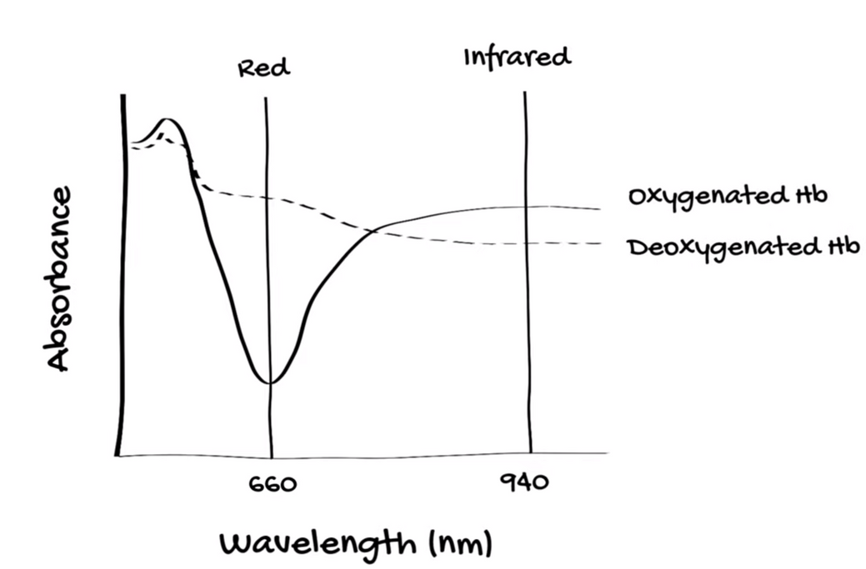
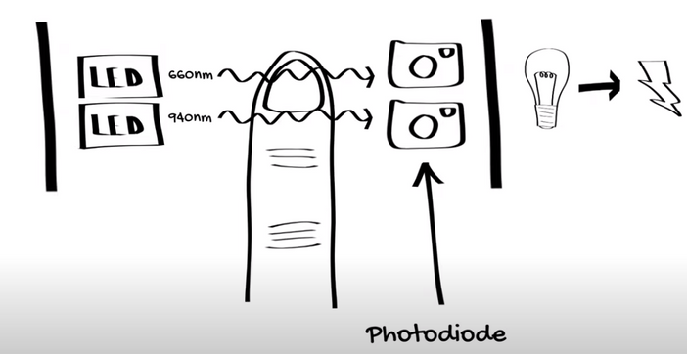
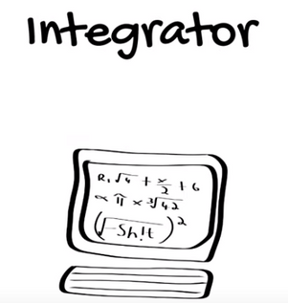
DSP

Slide 12
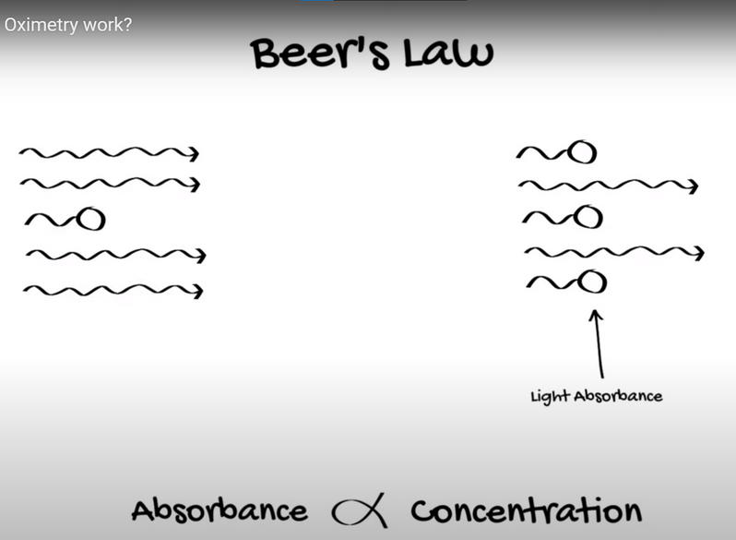
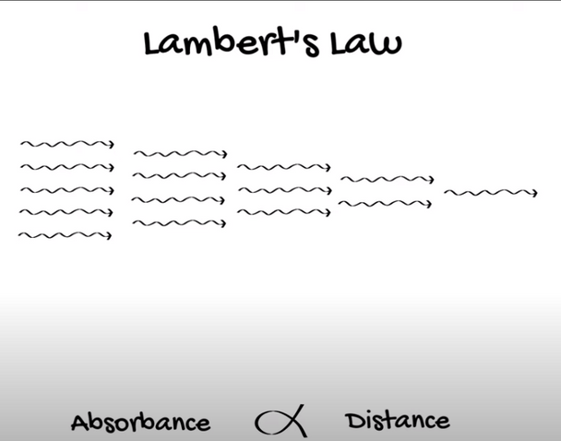

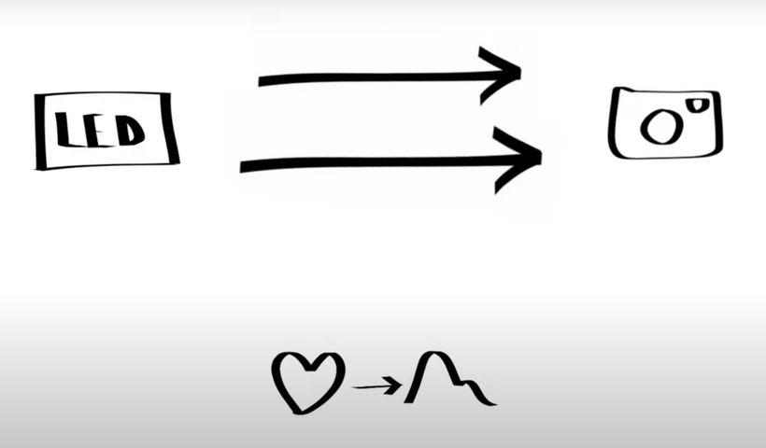

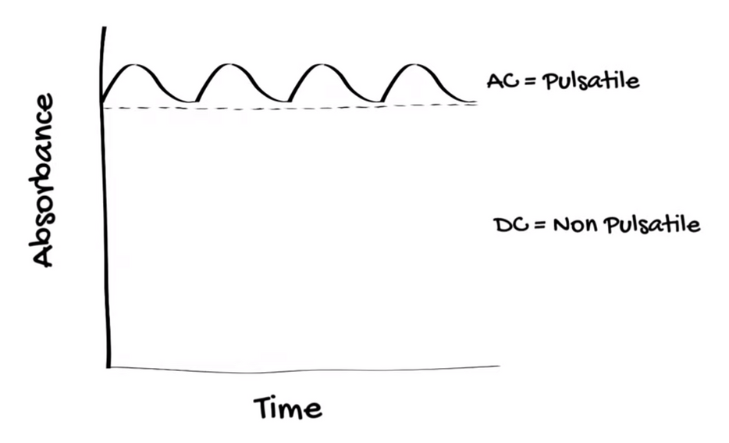
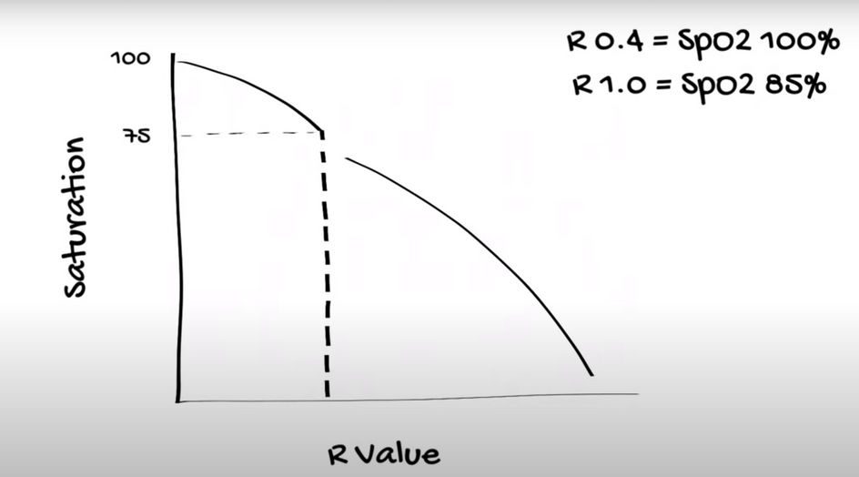

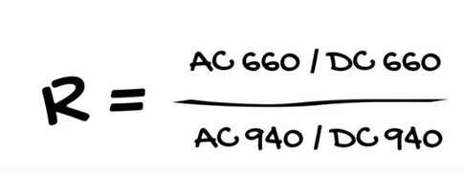
Whats in for Our
DSP?
emitter
photo-diode
travelled
measures
R value gives the saturation values also called SpO2.
both ratios for each light are combined into another ratio called “R”
measures the pulsating
component of signal by comparing AC and DC values of the signal

Slide 13
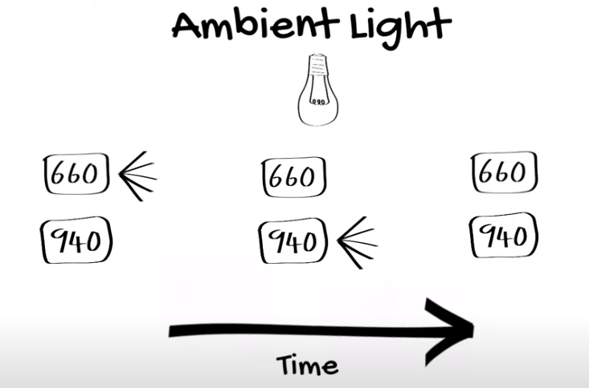
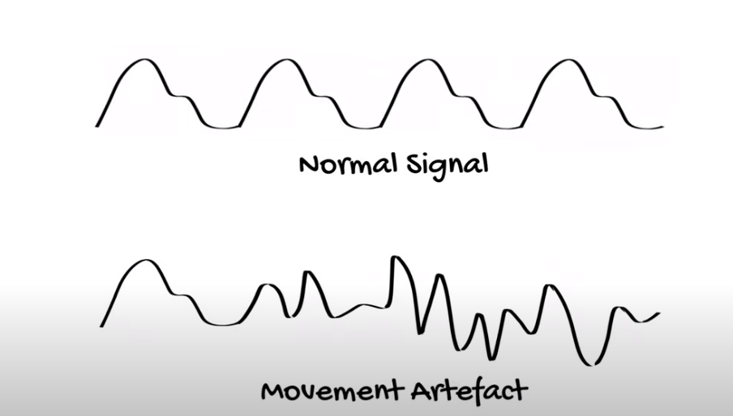
But THATS NOT IT for our DSPs
Motion can cause huge deviations from correct reading. Therefore the pulsating signal is amplified and averaged over time interval to remove any movement artefact from it.
To remove the affect of ambient light from surrounding 3 types of reading are taken. When Both lights are off external ambient light is detected.

Slide 14
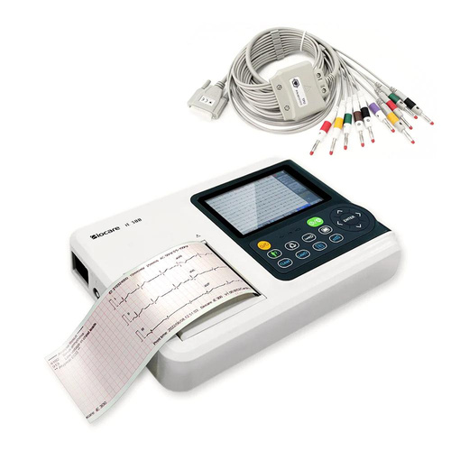
Portable ECG Device
Handheld device that records the electrical activity of the heart through electrodes placed on the skin, enabling convenient monitoring of heart rhythm and detecting abnormalities on the go.
Crucial DSP algorithms include finite impulse response (FIR) or infinite impulse response (IIR) filters for noise elimination, peak detection algorithms like the Pan-Tompkins algorithm for R-wave identification, thresholding techniques for peak identification.
How do they work exactly?

Slide 15
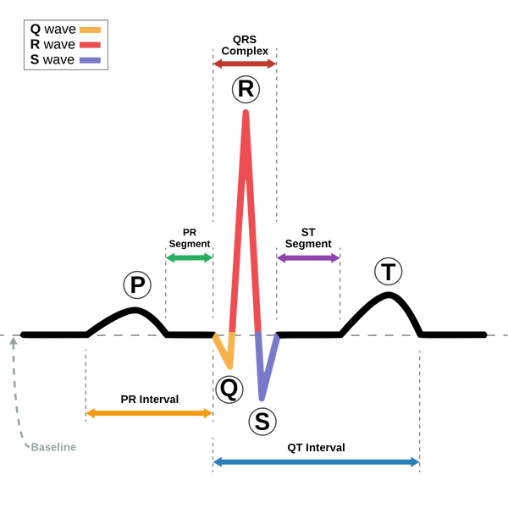
The standard ECG waveform consists of several distinct components:
P Wave: Represents atrial depolarization, the electrical activity associated with the contraction of the atria.
QRS Complex: Indicates ventricular depolarization, the electrical activity associated with the contraction of the ventricles. It's typically a complex waveform due to the rapid and coordinated activation of the ventricular muscle.
T Wave: Reflects ventricular repolarization, the recovery phase of the ventricles as they prepare for the next heartbeat.
Ideal ECG cycle
Electrocardiography is a diagnostic tool used to measure and record the electrical activity of the heart over a period of time. The electrical impulses generated by the heart muscle during each heartbeat are detected by electrodes placed on the skin, typically on the chest, arms, and legs. These electrodes detect the electrical signals and transmit them to the ECG machine, which amplifies and records the data.
An ECG represents the electrical activity of the heart in the form of a graph or series of waves.

Slide 16
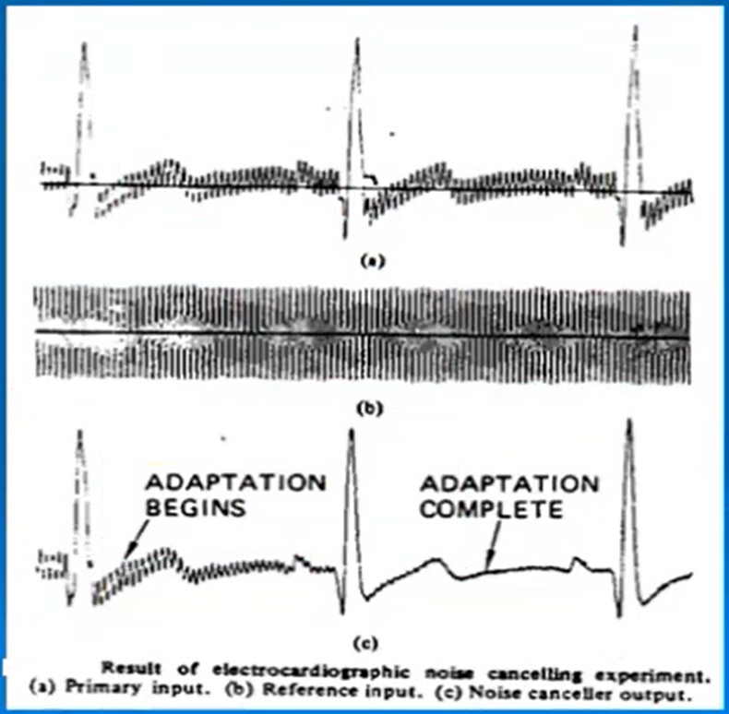
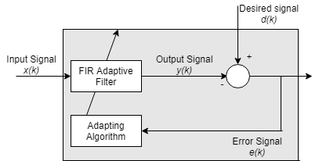
What’s the need of DSP?
Power line interference is the unwanted electrical noise generated by nearby power lines or electrical equipment, induced onto the ECG recording system through electromagnetic coupling, resulting in periodic fluctuations or spikes superimposed on the ECG waveform.
The interference manifests as high-frequency noise that can obscure or distort the underlying cardiac signal, making it challenging to accurately interpret the ECG and diagnose cardiac abnormalities.
Solution: Adaptive Power line interfence canceller is a
widely adopted approach for efficiency in this case. While another approach widely adopted is to deploy a notch filter at 60hz to eliminate these interferences.

Slide 17
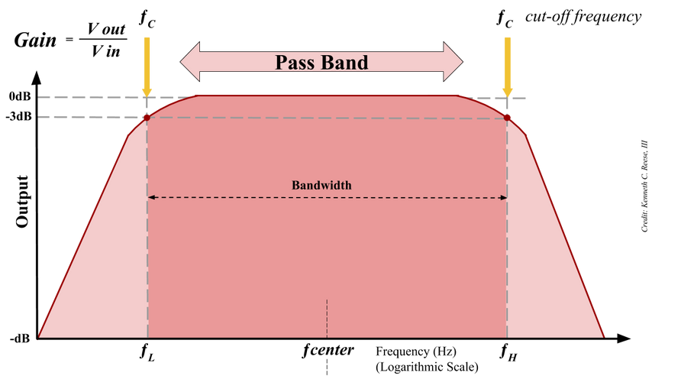
What’s the need of DSP?
Solution: To remove the dc offset, averaging filter is first used to smooth out the wave, which effectively reduces the impact of dc offset. Whereas, further application of bandpass filter (typically 0.5 Hz to 100 Hz frequency range is allowed) proves to be helpful in removal of muscle noise. Whereas, if for the overall system, if only adaptive noise filtering is implemented then it’d efficiently solve all the problems mentioned till now, whereas for the filtering of only the individual components, conventions have been communicated.
Muscle noise and DC shift are another unwanted artifacts that can distort the ECG signal.
Muscle noise, also known as electromyographic (EMG) interference, arises from the electrical activity of skeletal muscles surrounding the heart.
DC shift can occur due to various factors, including electrode polarization, electrode contact impedance, or movement artifacts. When present, DC shift can obscure the small amplitude variations in the ECG waveform, making it difficult to distinguish between normal cardiac activity and noise.
Bandpass Filter

Slide 18
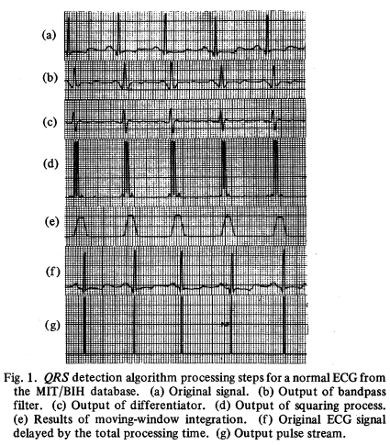
What’s the need of DSP?
After the noise filtering, further more DSP techniques are applied to isolate the desired outcome from the obtained noise-free ECG signal .
These techniques involve, application of a bandpass filter to isolate the R peak, a differentiator function to enhance the slopes of QRS wave making the peaks of the wave more pronounced, squaring function to convert all the values to positive and enhance the high amplitudes to make peak identification easy, moving window function (similar to moving average function) to break the signal into multiple windows and integrating them over time to obtain a smoothed wave, and threshold conditioning to identify the peaks.

Slide 19
Glucose Meter
It measures the glucose level in human blood by an invasive method. Nowadays it is found in every household.
DSP techniques include signal conditioning, noise reduction using filtering methods like Kalman filters or wavelet transforms, and calibration algorithms to convert sensor signals into glucose values
The primary mathematical principle involved is the relationship between the glucose concentration in the blood and the electrical current produced by the reaction on the test strip
Working Principle??

Slide 20
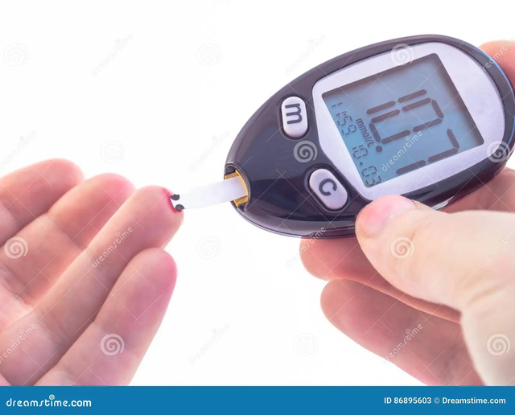
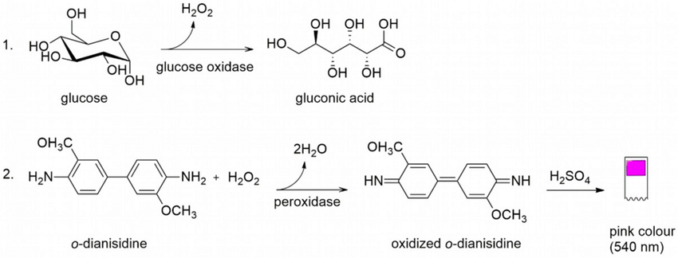
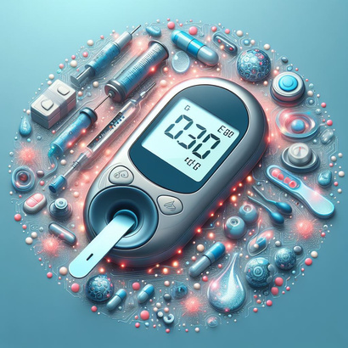
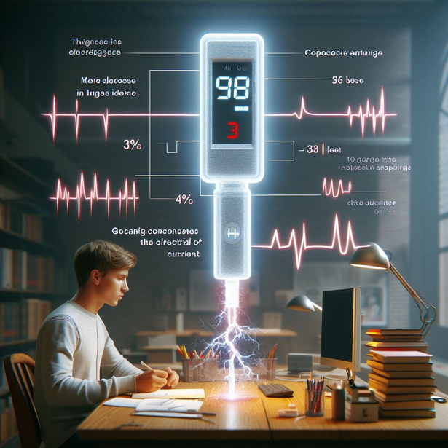
Sample Collection: A small amount of blood sample
Test Strip Reaction: Each test strip contains an enzyme called glucose oxidase. This enzyme reacts with the glucose in the blood sample creates gluconic acid
Electrical Signal Generation: Glucometer runs an electronic current that is capable of reading the ferrocyanide and identifying the amount of glucose present in the blood sample.
Chemical Reaction: The gluconic acid then reacts with ferricyanide and form ferrocyanide
Glucose Level Display: number appearing corresponds the strength of the electrical current. Hence more glucose in the sample, the higher the number.

Slide 21
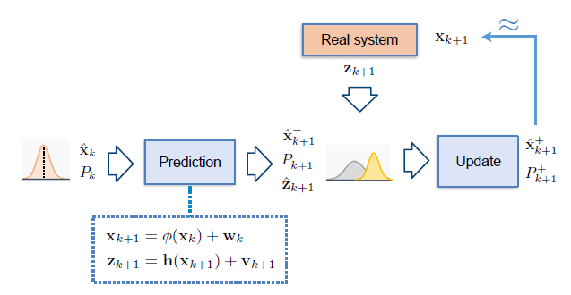
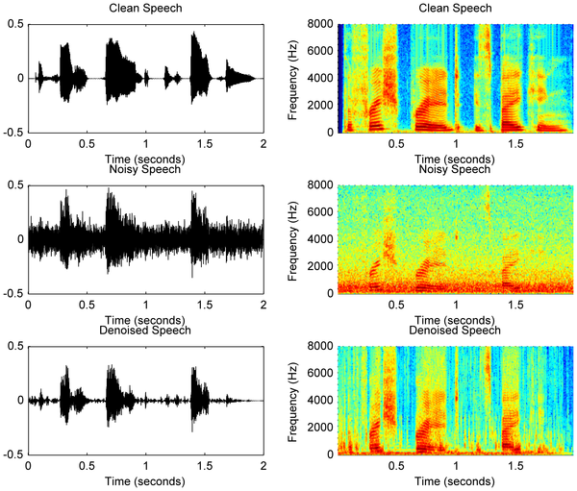
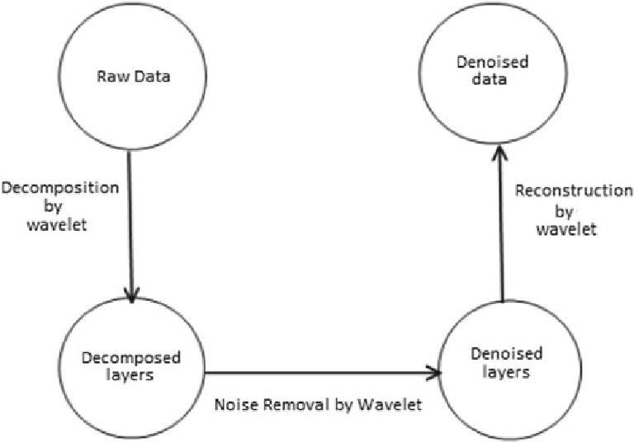
But THATS NOT IT for our DSPs!!
Kalman Filters: Kalman filters are used when signal consists of noisy observations of some linear dynamical system’s state. Kalman filter aims to recursively provide better and better estimates of the underlying system’s state
Noise Reduction Using Filtering Methods:
Wavelet Transforms: Wavelet transforms cut up data, functions, or operators into different frequency components, and then study each component with a resolution matched to its scale.
Calibration Algorithms to Convert Sensor Signals into Glucose Values
The aim of these algorithms is to establish a real-time self-adjusting calibration method to compensate for signal drift and sensitivity attenuation of subcutaneous implantable glucose sensors

Slide 22

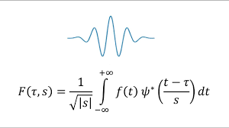
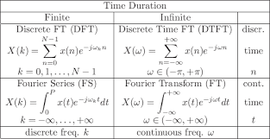
Wavelet Transforms:
DTFT Transforms:
While the Fourier transform creates a representation of the signal in the frequency domain, the wavelet transform creates a representation of the signal in both the time and frequency domain, thereby allowing efficient access of localized information about the signal
The wavelet expansion directly reflects the properties of / in physical space, while the Fourier expansion is perfect in frequency space.

Slide 23
In Essence
Measurement
DSP processes electrical signals from glucose sensors, converting them into glucose concentration readings.
Techniques
Kalman filters/ wavelet transforms
calibration algorithms
Trend/ Relationship
This relationship is typically linear, meaning that as the glucose concentration increases, so does the electrical current

Slide 24
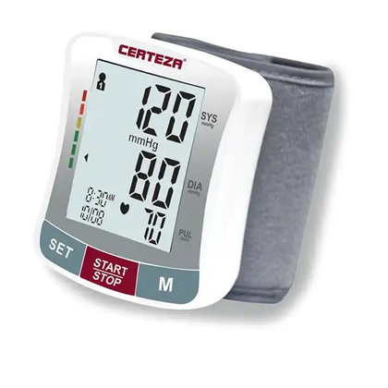
Blood Pressure Monitoring
Measures blood pressure through an inflatable cuff placed around the arm providing a convenient and painless method for monitoring blood pressure.
Specific DSP algorithms involved are finite impulse response (FIR) filters for noise removal, peak detection algorithms for identifying Korotkoff sounds.
How do they work exactly?

Slide 25
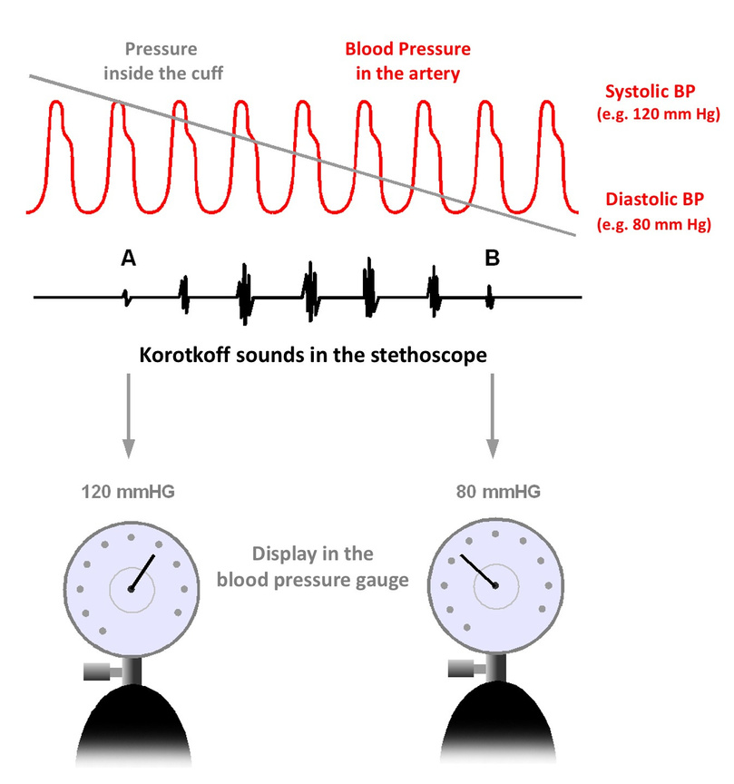
What’s the need of DSP?
Filtering is the process of selectively attenuating or removing specific frequency components from a signal while preserving others. In the context of Korotkoff sound detection, bandpass filtering techniques are applied to isolate frequencies associated with Korotkoff sounds, typically in the range of 0-1000 Hz. This helps to separate the desired signal from background noise and other interference present in the recording.
Envelope detection is a signal processing technique used to extract the envelope of a modulated signal, which represents the magnitude variations of the signal over time. In the context of identifying Korotkoff sounds during blood pressure measurement, envelope detection plays a crucial role in highlighting the amplitude changes corresponding to the opening and closing of the artery as the cuff pressure is gradually reduced during cuff deflation
Thresholding is applied further to identify and isloate the peaks necessary for the identification of preferred data.

Slide 26
Conclusion
Modern digital signal processing (DSP) techniques are integral to medical technology, enabling efficient data processing, analysis, and control in healthcare applications. By rapidly executing fundamental mathematical operations, like transforms and filters, DSP empowers medical devices to deliver accurate insights, enhancing patient care and treatment outcomes in the dynamic landscape of healthcare technology.

Slide 27
References
https://www.yalemedicine.org/conditions/pulse-oximetry#:~:text=The%20device%20emits%20light%20that,by%20the%20tissue%20and%20blood.
https://engineering.mit.edu/engage/ask-an-engineer/how-do-glucometers-work/
https://www.youtube.com/watch?v=MHPgamGQmDY
https://www.intechopen.com/chapters/74096#:~:text=While%20the%20Fourier%20transform%20creates,localized%20information%20about%20the%20signal.
https://www.youtube.com/watch?v=RYZ4daFwMa8
https://www.youtube.com/watch?v=WUFFFlXPVWg
https://www.youtube.com/watch?v=NkGjfHVfWHY
https://www.youtube.com/watch?v=pJdlmDNEe_k

Slide 28
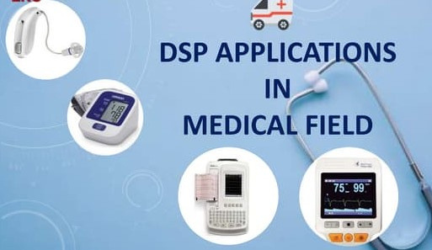
Thank You
Any questions?

